Slide 1
I have many
feelings!
My name is:
This is a picture of me! I can paste one or draw myself.

Slide 2
Here are some feelings I may have.
Happy
Sad
Mad
Scared
Graphic: Hannah Shack

Slide 3
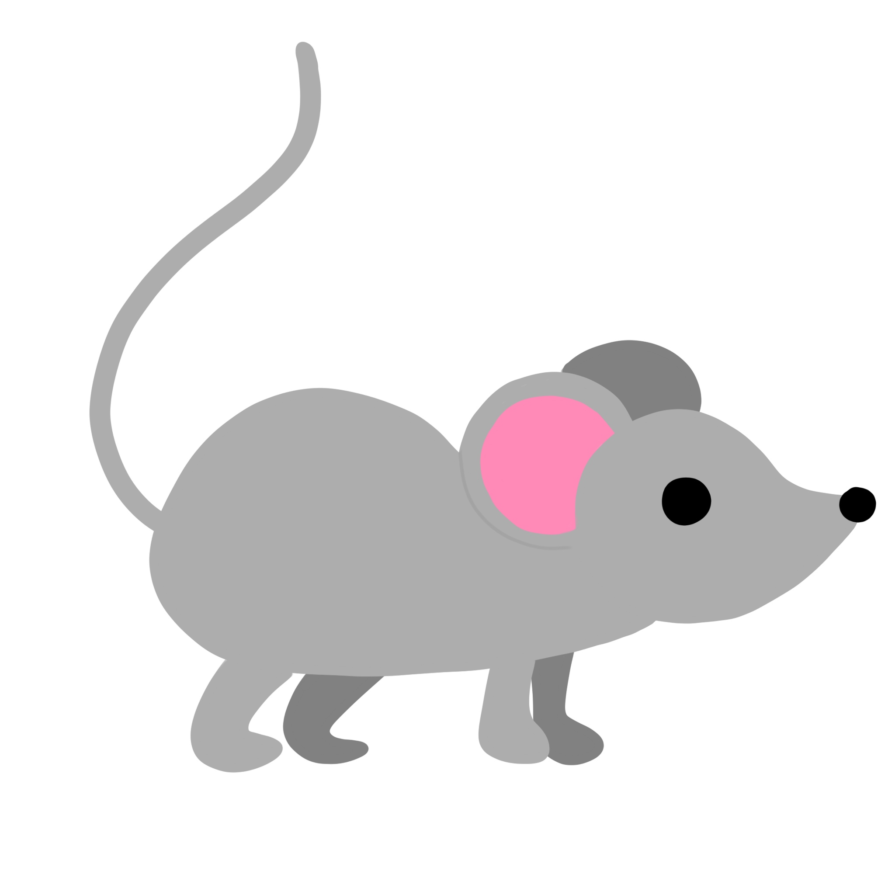
Sometimes my feelings are small like a mouse
and sometimes BIG like a lion
Graphic: Hannah Shack
My feelings can change throughout the day.

Slide 4
This is one feeling I have now.
Feeling Word:
This is what my face looks like when I have this feeling. I can draw my feeling or paste my photo here.

Slide 5
The size of my feeling now is…
Big Feelings
Small Feelings
Graphic: Hannah Shack

Slide 6
To be Safe and Strong it’s Important that I Learn to Feel Calm
When you are calm, you don’t have small or big feelings.
When you are calm, you don’t feel worried or scared.
When you are calm, You feel still. You feel relaxed. You feel safe.
Graphic: Courtney Vickery

Slide 7
What are some things Adults can do to help my body feel calm and safe?
An adult can
hold me
An adult can read a book to me
An adult can sit and rock me
An adult can
sing to me
Graphic: Courtney Vickery

Slide 8
What are some things I can do to help my body feel calm and safe?
I can blow bubbles
I can play with sand
I can play
with clay
I can take deep breaths
Graphic: Courtney Vickery

Slide 9
The End
This is what I look like when I am CALM
I can paste a photo of me looking calm or draw a picture.

Slide 10
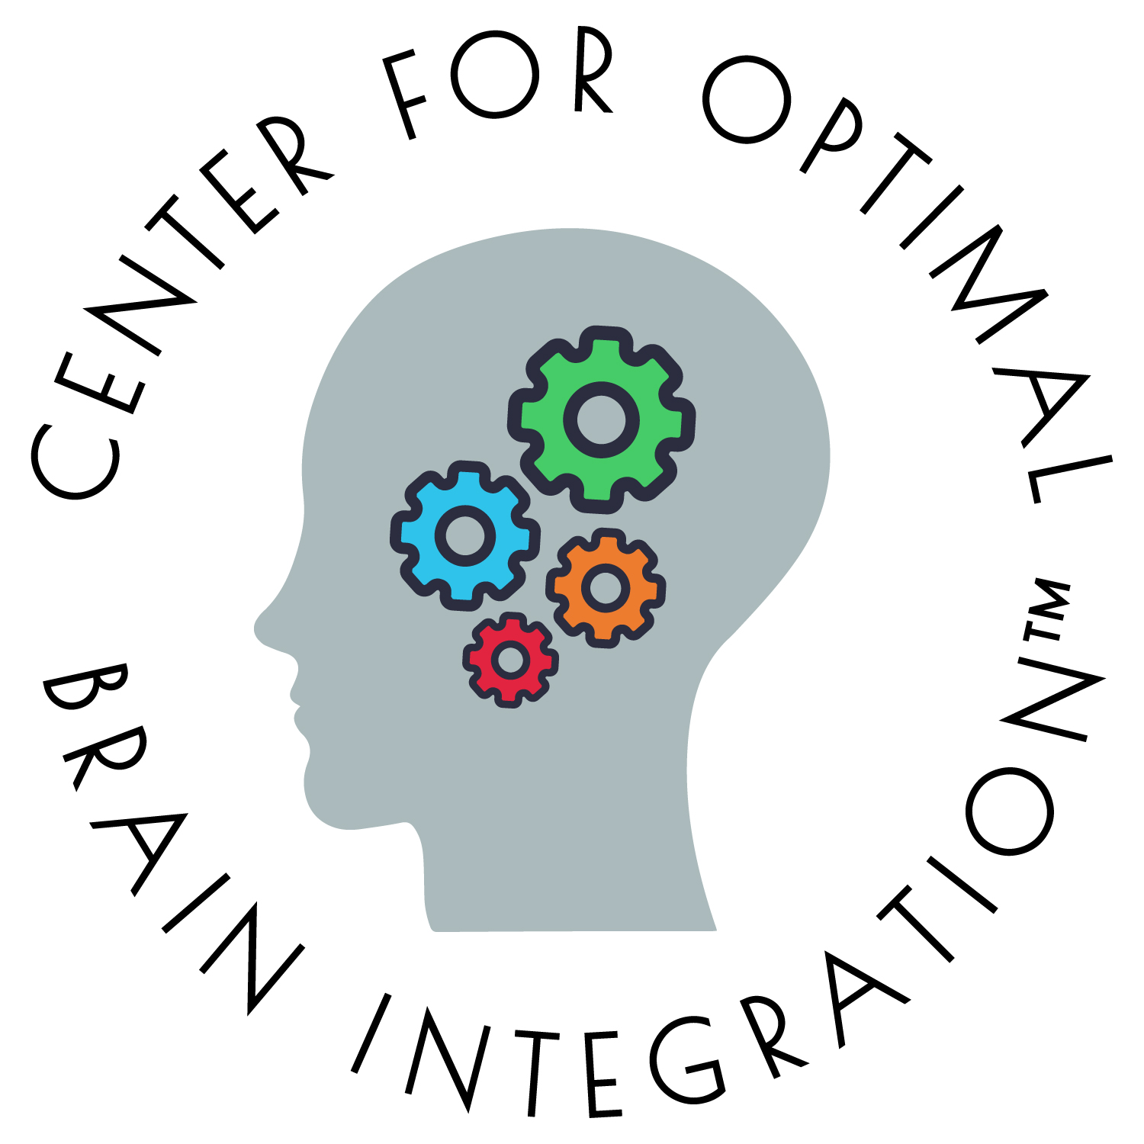
Developed by the Center for Optimal Brain Integration™ to promote emotional literacy and self-regulation for preschool children
For a downloadable version visit: www.optimalbrainintegration.com

